Slide 1
ICS 141 – Programming With Objects
Lecture 10 – Robert Jahn
Based on the slides of Dr. Daniel Liang

Slide 2
Schedule
April 1st: Abstract classes, interfaces, ArrayList
April 8th: Recursion
April 15th: Exception Handling
April 22nd: File I/O
April 29th: Final Exam

Slide 3
Changes
No midterm 2
Over the next week, I’ll post backup exams for those that missed the first exam. If anyone that took the first exam would like to try again, you may also try the backup exam and I’ll take your best score.
Final will be a take-home final exam. It’ll be submitted via D2L.

Slide 4
Abstract Classes
We’ve been working with larger and more complex solutions. To this point, any class we have created has been a concrete/normal class. Up next, we are going to discover a new type of class: The abstract class.
Let’s consider the example we discussed a few weeks ago.
Let us write out a solution that represents Students, Grad Students, Instructors, and Professors.

Slide 5
Abstract Classes
So, that is the basic idea behind an abstract class.
A class that is so abstract that we have no need in actually creating an object based on it. In fact, java will not allow us to do this. It will give a compiler error if we try.
This begs the question. If we cannot make an object of an abstract class, what is the point of making an abstract class?

Slide 6
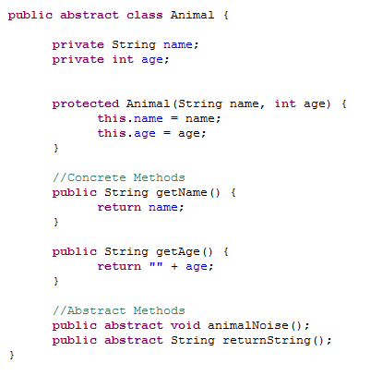
Let’s Jump into an Example

Slide 7
Abstract Classes - Distinctions
As mentioned, an abstract class is one that we cannot use to create objects.
We are unable to use the new operator to create an object as we have usually done.
Conversely, a concrete class is a class that we can use to create objects.
Every class we’ve created to this point has therefore been a concrete class.
Thinking of inheritance for a moment ~
We know that classes become more concrete as we move down the inheritance chain.
That is, the Object class, at the top, is the most general.
The Dog class, on the other hand, is fairly specific.
The idea behind an abstract class ~
A class so general that it really serves no purpose as an actual object.
We’ll simply use the abstract class to extend other classes.

Slide 8
Abstract Classes
Essentially, what we have is that abstract classes will serve as a blueprint for future classes to be created.
We’ll define some data fields, constants and methods to be used in future classes.
We’ll still inherit all visible members as we do with normal inheritance.
Within an abstract class, we can have two types of methods:
Normal methods and abstract methods.
Normal methods we’ve seen before.
Abstract methods are new.

Slide 9
Abstract Methods
We declare an abstract method for later use in the subclass.
We only declare the method, using the abstract keyword ~
modifier abstract returnType methodName();
public abstract void print();
Note the terminating semicolon.
We do not define the method, we simply declare it for later use.

Slide 10
Abstract Methods
If we declare a method to be abstract within a class, this forces us to also define the class as abstract.
Therefore, we cannot include an abstract method in a class that is not labeled as abstract.
This brings up an interesting point.
Say we have a concrete subclass that extends an abstract superclass. Say this abstract superclass has a pair of public, abstract methods declared.
We know that the subclass inherits these two methods if they are visible.
Therefore, we inherit the declarations and must implement them in the concrete subclass.
If we do not, the subclass must also be defined as abstract, meaning it is not entirely useful to us.
We must take care when defining our abstract classes as any concrete subclass we create must be able to properly implement its abstract methods.

Slide 11
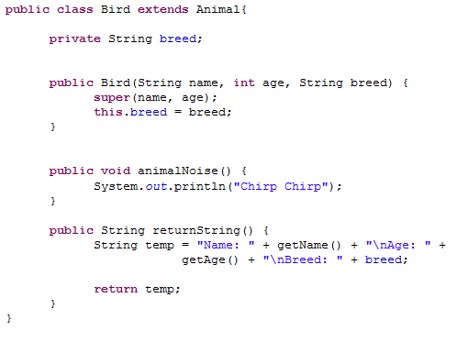
Bird Class - Concrete

Slide 12
Abstract Classes – Some Notes
We’ve been discussing the case where we have an abstract superclass and a concrete subclass.
What about the reverse?
Can we have a concrete superclass and an abstract subclass which extends it?
Yes!
Think of the Object class. This is a concrete class. We can create instances of the Object class. We can then define an abstract class. If we do not specify an inheritance relationship, we implicitly extend the Object class.

Slide 13
Abstract Subclass

Slide 14
Abstract Classes
We know we cannot use the new operator to actually create an instance of an abstract class.
However, we can still use it as a data type.
Therefore, the following would be alright ~
Animal[] animals = new Animal[10];
We’d then set these array references to actual concrete objects ~
animals[0] = new Bird(“Petey”, 5, “Finch”);

Slide 15
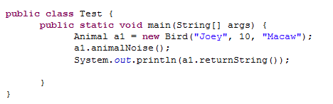
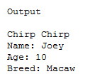
Bird Class - Concrete

Slide 16
Exercise #8a

Slide 17
abstract method in abstract class
An abstract method cannot be contained in a concrete class. If a subclass of an abstract superclass does not implement all the abstract methods, the subclass must be defined abstract. In other words, in a concrete subclass extended from an abstract class, all the abstract methods must be implemented, even if they are not used in the subclass.

Slide 18
object cannot be created from abstract class
An abstract class cannot be instantiated using the new operator, but you can still define its constructors, which are invoked in the constructors of its subclasses. For instance, the constructors of Animal are invoked in the Bird class and perhaps some other subclasses we may define.

Slide 19
abstract class without abstract method
A class that contains abstract methods must be abstract. However, it is possible to define an abstract class that contains no abstract methods. In this case, you still cannot create instances of the class using the new operator. This class is used as a base class for defining a new subclass. An abstract class may also contain concrete methods.

Slide 20
superclass of abstract class may be concrete
A subclass can be abstract even if its superclass is concrete. For example, the Object class is concrete, but its subclasses, such as Animal, may be abstract.

Slide 21
concrete method overridden to be abstract
A subclass can override a method from its superclass to define it abstract. This is rare, but useful when the implementation of the method in the superclass becomes invalid in the subclass. In this case, the subclass must be defined abstract.

Slide 22
abstract class as type
You cannot create an instance from an abstract class using the new operator, but an abstract class can be used as a data type. Therefore, the following statement, which creates an array whose elements are of Animal type, is correct.
Animal[] a1 = new Animal[10];

Slide 23
Interfaces
What is an interface?
Why is an interface useful?
How do you define an interface?
How do you use an interface?

Slide 24
What is an interface? Why is an interface useful?
An interface is a class like construct that contains only constants and abstract methods. In many ways, an interface is similar to an abstract class, but the intent of an interface is to specify behavior for objects. For example, you can specify that the objects are comparable, edible, cloneable using appropriate interfaces.

Slide 25
Define an Interface
To distinguish an interface from a class, Java uses the following syntax to define an interface:
public interface InterfaceName {
constant declarations;
method signatures;
}
Example:
public interface Edible {
/** Describe how to eat */
public abstract String howToEat();
}

Slide 26
Interface is a Special Class
An interface is treated like a special class in Java.
Like an abstract class, you cannot create an instance from an interface using the new operator, but in most cases you can use an interface more or less the same way you use an abstract class.
For example, you can use an interface as a data type for a variable, as the result of casting, and so on.
One major difference is that we can implement multiple interfaces.
This allows us to mimic multiple inheritance.

Slide 27
Example
You can now use the Edible interface to specify whether an object is edible. This is accomplished by letting the class for the object implement this interface using the implements keyword. For example, the classes Chicken and Fruit implement the Edible interface.

Slide 28

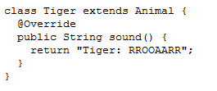
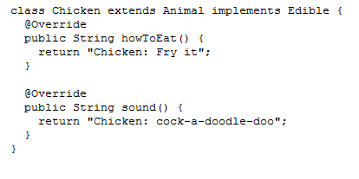
public interface Edible {
/** Describe how to eat */
public abstract String howToEat();
}

Slide 29

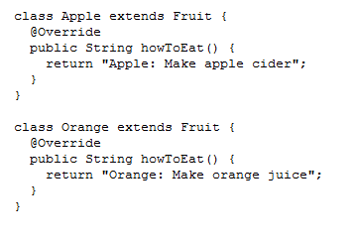
public interface Edible {
/** Describe how to eat */
public abstract String howToEat();
}

Slide 30
Omitting Modifiers in Interfaces
All data fields are public final static and all methods are public abstract in an interface. For this reason, these modifiers can be omitted, as shown below:
A constant defined in an interface can be accessed using syntax InterfaceName.CONSTANT_NAME (e.g., T1.K).

Slide 31
Interfaces vs. Abstract Classes
In an interface, the data must be constants; an abstract class can have all types of data.
Each method in an interface has only a signature without implementation; an abstract class can have concrete methods.
 | Variables | Constructors | Methods
Abstract class | No restrictions | Constructors are invoked by subclasses through constructor chaining. An abstract class cannot be instantiated using the new operator. | No restrictions.
Interface | All variables must be public static final | No constructors. An interface cannot be instantiated using the new operator. | All methods must be public abstract instance methods

Slide 32
Interfaces vs. Abstract Classes, cont.
All classes share a single root, the Object class, but there is no single root for interfaces. Like a class, an interface also defines a type. A variable of an interface type can reference any instance of the class that implements the interface. If a class implements an interface, this interface plays the same role as a superclass. You can use an interface as a data type and cast a variable of an interface type to its subclass, and vice versa.
Suppose that c is an instance of Class2. c is also an instance of Object, Class1, Interface1, Interface1_1, Interface1_2, Interface2_1, and Interface2_2.

Slide 33
Caution: conflict interfaces
In rare occasions, a class may implement two interfaces with conflict information (e.g., two same constants with different values or two methods with same signature but different return type). This type of error will be detected by the compiler.

Slide 34
Whether to use an interface or a class?
Abstract classes and interfaces can both be used to model common features. How do you decide whether to use an interface or a class? In general, a strong is-a relationship that clearly describes a parent-child relationship should be modeled using classes. For example, a staff member is a person. So their relationship should be modeled using class inheritance. A weak is-a relationship, also known as an is-kind-of relationship, indicates that an object possesses a certain property. A weak is-a relationship can be modeled using interfaces.

Slide 35
Interfaces
To this point, we’ve discussed interfaces as they have been through JDK 7.
In JDK 8, we introduced a minor, but important change, when it comes to interfaces.
JDK 8 introduced the idea of the default method. A default method is one we define in an interface. Instead of being a simple declaration, it serves as a method with a default implementation that may or may not be overridden later.

Slide 36
Interfaces
Why did java introduce the default method? Let’s look at an example.

Slide 37
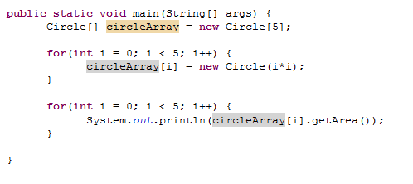
Array of Objects, cont.
Summarizing the areas of the circles

Slide 38
ArrayList
You can create an array to store objects. But the array’s size is fixed once the array is created. Java provides the ArrayList class that can be used to store an unlimited number of objects.
We have dealt with this fact through a few of the labs/assignments. We have handled it by including that counter variable to keep track of the actual amount of objects added/created.

Slide 39
The ArrayList Class

Slide 40
ArrayList
The ArrayList class is a very nice change of pace from the normal array.
The class/object itself keeps track of all of the size questions.
It will automatically keep a dynamic size as we alter the ArrayList object.
It will reduce the size when we remove an element.
It will increase the size as we add elements.

Slide 41
ArrayList
One caveat to keep in mind here ~
With arrays, we could have arrays of anything.
Primitive types
Reference types
With ArrayLists, we can only store reference types.
So, we can’t store ints, doubles, chars, etc…
Instead, we’d store the wrapper objects for these primitive types.
Integer, Double, Character, etc…

Slide 42
ArrayList Syntax
How do we create an ArrayList object? Let’s compare to a normal array.
Student[] array = new Student[30];
ArrayList<Student> array = new ArrayList<Student>();
Note the difference. For a normal array, we specify a size upon creation, 30.
For an ArrayList, the size will initially be 0 as we don’t have anything stored upon initial creation.
For the normal array, the size will be a static 30.
For the ArrayList, the size will change as we add/remove elements to/from the ArrayList object.

Slide 43
ArrayList Syntax
Generic syntax
ArrayList<T> refVar = new ArrayList<T>();
This is really our first dose of generic/template programming in action other than the polymorphic reference variables we have been using.
The T here can be replaced with any type of class in Java.
ArrayList<Dog> dogs = new ArrayList<Dog>();

Slide 44
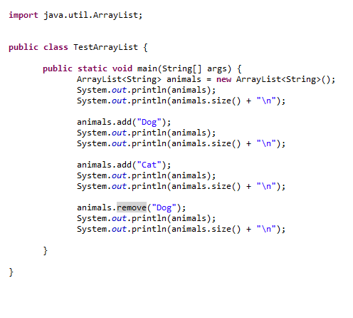
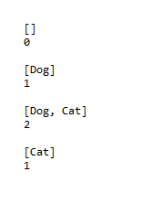
ArrayList Syntax

